Slide 1
An empirical comparison of machine learning classification algorithms &
Topic Modeling
A quick look at 145,000 World Bank documents
Olivier Dupriez, Development Data Group
Slides prepared for DEC Policy Research Talk, February 27, 2018

Slide 2

The 2014 call for a Data Revolution
Use data differently (innovate)
New tools and methods → A comparative assessment of machine learning algorithms
Use different data (big data, …)
Text as data → Topic modeling applied to the World Bank Documents and Reports corpus
Notes:
The presentation covers two topics that are not directly related. Both are implemented by the Data Group as a response to the call for innovation and modernization in data use. The first project presented (comparative assessment of machine learning classification algorithms) aims to contribute to modernize data analysis and use at the Bank and in client countries, by documenting the use and performance of ML algorithms. The second project (topic modeling) aims to demonstrate the use of unsupervised machine learning tools for analyzing unstructured data (text) to develop better knowledge (data and documents) discovery tools.

Slide 3
An empirical comparison of machine learning classification algorithms applied to poverty prediction
A Knowledge for Change Program (KCP) project

Slide 4
Documenting use and performance
Many machine learning algorithms available for classification
We document the use and performance of selected algorithms
Application: prediction of household poverty status (poor/non-poor) using easy-to-collect survey variables
Focus on the tools → use “traditional” data (household surveys)
Not a new idea (SWIFT surveys, proxy means testing, survey-to-survey imputation, poverty scorecards; most rely on regression models)
Possible use cases: targeting; simpler/cheaper poverty surveys
Notes:
A large collection of classification algorithms is now available (in open source R or Python packages and libraries). The CARET package (R) for example, can exploit close to 240 different classification algorithms, most of them offering multiple options and tuning parameters. As data scientists, we have a very powerful and diverse toolbox in our hands. There is a need for some systematic, comparative assessments of (some of) these tools. There is also a need for more transparency, reproducibility, and adaptability in the way they are used. Our KCP project allowed us to initiate such an assessment. We decided to focus on classification (not regression) algorithms. Poverty prediction was chosen as the “challenge” for this comparative assessment. The key output of the project will be a collection of open and reproducible scripts (in the form of well-documented Jupiter (Python) notebooks) published on GitHub. A working paper will also be produced (around June 2018).

Slide 5
Key question
NOT
“What is the best algorithm for predicting [poverty]?”
BUT
“How can we get the most useful [poverty] prediction for a specific purpose?”
Notes:
We do not expect to identify an “ideal” algorithm for poverty prediction. The best algorithm(s) for a specific purpose will depend on (i) the data themselves, and (ii) the selected quality metric(s) used to evaluate its (their) performance.

Slide 6
Approach
Apply 10 “out-of-the-box” classification algorithms
Malawi IHS 2010 – Balanced classes (52% poor ; 12,271 hhlds)
Indonesia SUSENAS 2012 - Unbalanced classes (11% poor ; 71,138 hhlds)
Data: mostly qualitative variables, including dummies on consumption (hhld consumed [item] – Yes/No). Did not try to complement with other data.
Challenge the crowd: data science competition to predict poverty status for 3 countries (including MWI)
Challenge experts to build the best model for IDN, with no constraint on method
Apply automated Machine Learning on IDN
Notes:
We not only compare the performance of ML algorithms, but also test different approaches to have our models developed.
The approach is to:
Make a selection of ten out-of-the-box classification algorithms, and apply them (with various options) to survey data from two countries (Susenas 2012 from Indonesia, and Integrated Household Survey 2010 from Malawi). We selected these two datasets because (i) for both countries, we have comparable survey datasets for years before and after the selected survey, which will allow us to test how our prediction models perform when applied to older or more recent data, and (ii) MWI provide data with a balanced class (~50% poor), and IDN with an unbalanced class (~11% poor).
Organize a data science competition (crowd sourcing) to test a much larger number of algorithms (including ensemble models). Data scientists compete to produce the best predictive models for 3 countries using “anonymized” data (participants are not informed of what the 3 countries are). MWI is one of these 3 countries (we selected countries for which the data are publicly available).
Contract highly-qualified experts to build the best possible model for predicting hhld poverty status for IDN, with no constraint imposed on the tools and methods (with the exception that the model must be implemented using open source solutions).
Test the application of the automated machine learning technique (a new approach under fast development).
The datasets used for this comparative assessment are subsets of the full survey datasets. Only easy-to-collect variables are used, which are mostly categorical (and mostly Boolean) variables. At the individual level, these variables include for example age, sex, education level, or marital status. At the household level, we have variables on geographic location, consumption/expenditure by item (converted into dummies: household reported a value or not), assets ownership, dwelling characteristics, and others (but no continuous variable other than the sample weight).

Slide 7
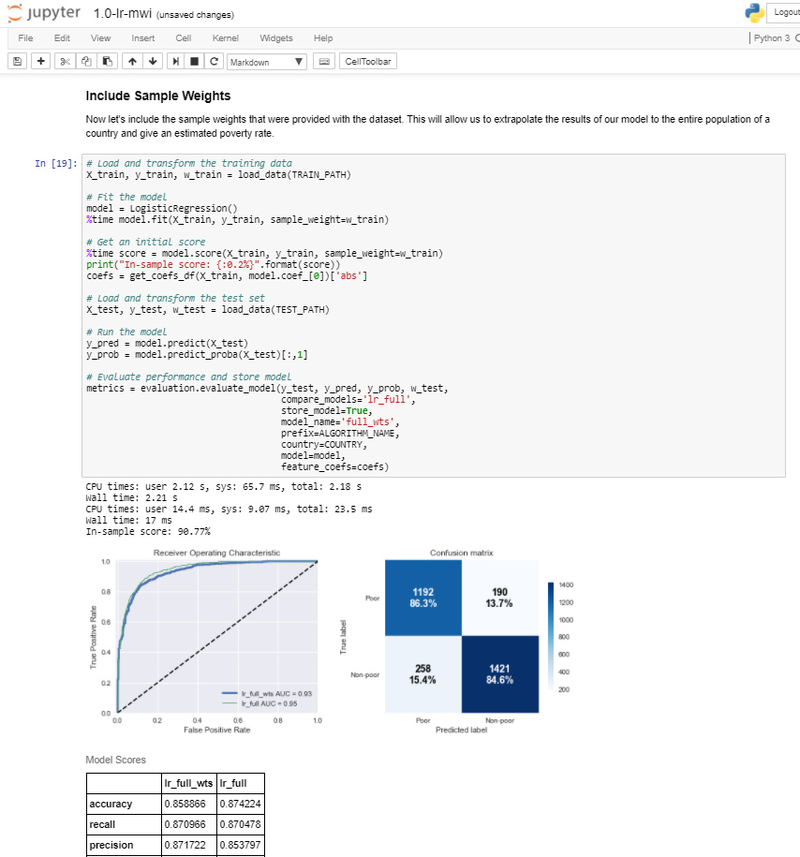
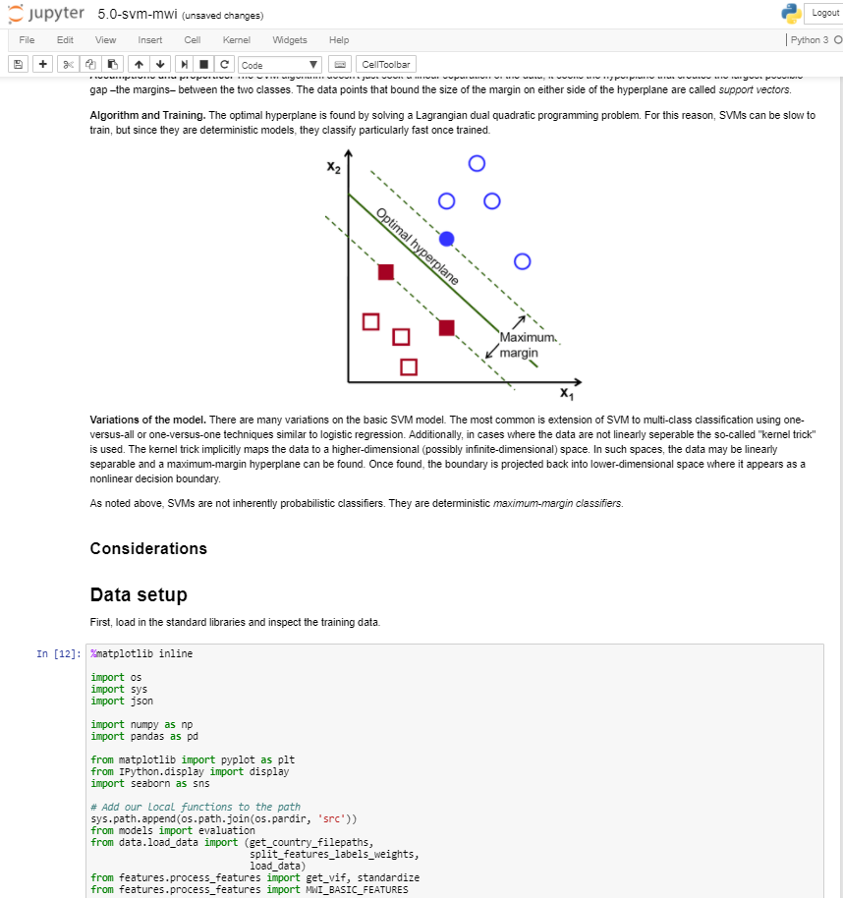

Reproducible and re-purposable output
Jupyter notebooks
→ Reproducible script, output, and comments all in one file
Notes:
The main output of the project are the reproducible and documented scripts that are used for applying and testing a large number of models. We generated multiple well-documented Python notebooks: one for data preparation, and 1 per country per algorithm (each one with multiple variants of the algorithm). All these materials will be published on GitHub and made openly available (some datasets will also be available publicly, but not the Indonesia survey data which are distributed – at a cost – by the Indonesia Bureau of Statistics). The notebooks will provide useful training and reference materials.

Slide 8
Multiple metrics used to assess performance
Predicted
Accuracy: (TP + TN) / All
Recall: TP / (TP + FN)
Precision: TP / (TP + FP)
F1 score: 2TP / (2TP + FP + FN)
Cross entropy (log loss)
Cohen - Kappa
ROC – Area under the curve
(Calculated on out-of-sample data)
Poor
Non poor
True positive TP | False negative FN
False positive FP | True negative TN
Poor
Actual
Non poor
Notes:
A comparison of performance requires a measure of quality. Multiple quality metrics are available to measure the performance of binary classification models. The accuracy of the models (percentage of correct predictions) is typically reported. But it is not sufficient, as this measure can be misleading. And if the predictions are used for targeting / identification of project beneficiaries, we might be more concerned by leakage of under-coverage than by the accuracy. We therefore use 7 measures of quality: accuracy, recall, precision, f1, cross-entropy (=log loss in the case of binary classification), and Cohen-Kappa.
Accuracy: “For what percentage of households did we make a correct prediction?”
Recall: “What percentage of the poor did we correctly classify as poor?”
Precision: “Among the household we predicted as poor, what percentage are actually poor?”
f1 is the harmonic average of precision and recall. It gives an indication of both precision and robustness (f1 will be penalized by a poor recall, even when the precision if high).
Cross entropy is the negative sum of the products of the logs of the predicted probabilities times the actual probabilities. Smaller values indicate a better prediction (https://jamesmccaffrey.wordpress.com/2016/09/25/log-loss-and-cross-entropy-are-almost-the-same/)
Cohen Kappa is a measure that compares the observed accuracy with an expected accuracy (the accuracy we would get by random guessing). Cohen Kappa = (observed accuracy - expected accuracy)/(1 - expected accuracy)
The ROC (Receiver Operating Characteristics) is a curve obtained by plotting the true positive rate and the false positive rate for all possible values of the “probability threshold” that distinguishes the two classes. Most models generate a probability for each household to be poor; by default, a household will be classified as poor if this probability is > 50, otherwise as non-poor. This threshold can be changed (e.g., one could decide to classify a household as poor if the probability is >= 60%). Thresholds from 0 to 1 are used to generate the plot. The diagonal represents a non-informative model. A “curve” passing by the top right corner represents the perfect prediction (perfect separation between poor and non-poor; no matter what threshold is used, the prediction will be correct). The higher the area under the curve (the closer to 1), the better the model. A random-guess will have an AUC of 0.5.

Slide 9
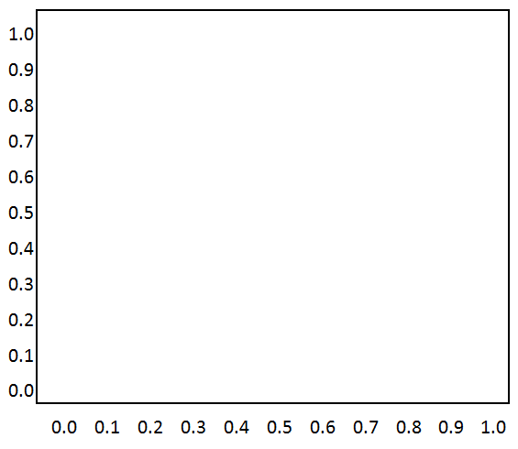
Area under the ROC curve (AUC)
Plot the true and false positive rates for every possible classification threshold
A perfect model has a curve that passes through the upper left corner (AUC = 1)
The diagonal represents random guessing (AUC = 0.5)
True positive rate
http://www.dataschool.io/roc-curves-and-auc-explained/
False positive rate

Slide 10
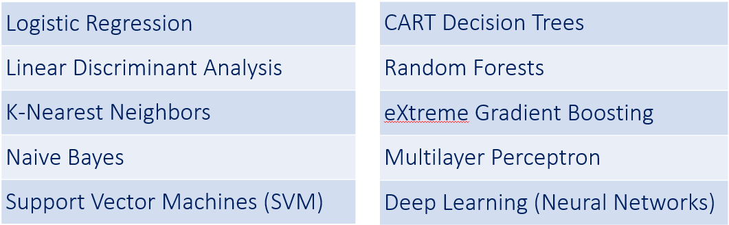
10 out-of-the-box classification algorithms
With scaling, boosting, over- or under-sampling as relevant
Implemented in Python; scikit-learn for all except XGBoost
Notes:
The first phase of our project was to select and apply ten out-of-the-box algorithms on the MWI and IDN data. The algorithms were selected for their “popularity” to solve binary classification problems. All were implemented in Python (scikit-learn library, except for XGBoost which has its own library). We explored model building across a wide range of modeling and features preprocessing choices. For all algorithms, we tested multiple options (all/selected features ; weighted/unweighted, under and over-sampling, and calibration or boosting where relevant). At the end, dozens of options were tried for each country.

Slide 11
Results - Out-of-the-box algorithms (MWI)
Algorithm (no feature engineering) (Results for selected models) | Accuracy | Recall | Precision | f1 | Cross entropy | ROC AUC | Cohen Kappa | Mean rank
Support Vector Machine (SVM) CV | 0.874 | 0.894 | 0.878 | 0.886 | 0.287 | 0.949 | 0.758 | 5.000
Multilayer Perceptron CV | 0.871 | 0.895 | 0.874 | 0.884 | 0.278 | 0.952 | 0.752 | 6.125
XGBoost selected features | 0.872 | 0.892 | 0.877 | 0.884 | 0.289 | 0.949 | 0.754 | 7.375
SVM CV Isotonic | 0.871 | 0.891 | 0.876 | 0.883 | 0.288 | 0.949 | 0.754 | 7.625
Logistic Regression – Weighted | 0.873 | 0.892 | 0.879 | 0.885 | 0.301 | 0.944 | 0.734 | 7.750
XGBoost, all features CV | 0.869 | 0.894 | 0.870 | 0.882 | 0.296 | 0.948 | 0.751 | 9.125
SVM Full | 0.864 | 0.886 | 0.868 | 0.877 | 0.298 | 0.945 | 0.733 | 10.625
Logistic Regression Full | 0.874 | 0.870 | 0.854 | 0.862 | 0.288 | 0.949 | 0.746 | 12.750
Random Forest, Adaboost | 0.866 | 0.878 | 0.878 | 0.878 | 0.580 | 0.947 | 0.744 | 13.000
Decision Trees, Adaboost | 0.866 | 0.878 | 0.878 | 0.878 | 0.353 | 0.941 | 0.737 | 13.000
No clear winner (best performer has a mean rank of 5)
Notes:
The table shows the outcome of the 10-algorithm assessment for the Malawi data (not all variants of the models are shown). This is based on exploring model building across a wide range of modeling and preprocessing choices. It is clear that none of the models is a clear winner. Support vector machine ranks first, but only with a mean rank of 5 across quality measures. Logistic regression has the highest accuracy, but is the worse performer for the f1 metric.

Slide 12
Results - Out-of-the-box algorithms (IDN)
Algorithm (Results for selected models) | Accuracy | Recall | Precision | f1 | Cross entropy | ROC AUC | Cohen Kappa | Mean rank
Logistic Regression | 0.910 | 0.456 | 0.662 | 0.540 | 0.213 | 0.923 | 0.483 | 3.25
Multilayer Perceptron | 0.909 | 0.543 | 0.619 | 0.579 | 0.496 | 0.923 | 0.548 | 4
Linear Discriminant Analysis | 0.906 | 0.405 | 0.648 | 0.499 | 0.231 | 0.912 | 0.457 | 5
Support Vector Machine | 0.902 | 0.208 | 0.782 | 0.329 | 0.204 | 0.932 | 0.312 | 5.125
K Nearest Neighbors | 0.904 | 0.372 | 0.647 | 0.472 | 0.541 | 0.865 | 0.423 | 6.5
XGBoost | 0.898 | 0.184 | 0.743 | 0.295 | 0.224 | 0.917 | 0.285 | 6.625
Naïve Bayes | 0.807 | 0.603 | 0.322 | 0.420 | 1.893 | 0.828 | 0.238 | 7.25
Decision Trees | 0.859 | 0.392 | 0.390 | 0.391 | 4.870 | 0.656 | 0.306 | 7.875
Random Forest | 0.892 | 0.107 | 0.729 | 0.187 | 0.592 | 0.832 | 0.210 | 8
Deep Learning | 0.884 | 0.000 | 0.000 | 0.000 | 0.349 | 0.896 | 0.000 | 9.5
No clear winner ; logistic regression again performs well on accuracy measure
Notes:
We can draw a similar conclusion from the results of the IDN models. The table summarizes the outcome of selected models of each class when we also consider preprocessing options (such as over- and under-sampling) and hyperparameter optimization using cross-validation. This table reports the best performing version of a model for each class of model that we explored. The models that perform best (for any quality measure) are not the same that performed best for MWI.

Slide 13
Results – Predicted poverty rate (IDN)
Difference between predicted and measured poverty rate
Logistic regression | -3.1%
Multilayer perceptron | -0.4%
Support vector machine | -8.2%
Decision trees | 0.0%
Random forest | -3.5%
Not a very good model, but achieves quasi-perfect prediction of the poverty headcount (false positives and false negatives compensate each other)
Estimated on full dataset
→ A good poverty rate prediction is not a guarantee
of a good poverty profile
Notes:
We can also measure the predicted poverty headcount. Much attention must however be paid to multiple measures. For Indonesia, the Decision Trees model which has poor precision and recall predicts the poverty rate almost exactly. This is due to the fact that it generates the same number of false positives and false negatives, which compensate each other. Using this prediction to produce a poverty profile would thus be misleading. In a worse case scenario, we could achieve perfect prediction of the poverty headcount without making a single correct prediction (imagine a country where 50% of the population is poor; if all poor are classified as non-poor, and vice-versa, the predicted poverty rate will be exact although all predictions are wrong).

Slide 14
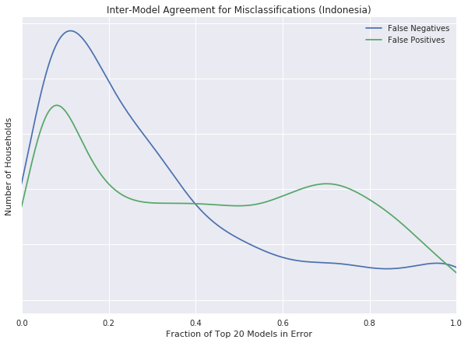
Ensembling (IDN)
Inter-model agreement for misclassifications (IDN)
Diversity of perspectives almost always leads to better performance
70% of the households were correctly classified by every one of the top 20 models
78% of poor households were misclassified by at least one model
We take advantage of this heterogeneity in predictions by creating an ensemble
Fraction of top 20 models in error
Notes:
Different models have different predictive abilities, and make different errors. One option to improve the quality of prediction is to build an ensemble of models, where we seek “multiple opinions”. Each selected model is given a weight. Each model in the ensemble predicts the poverty status. We then make a final prediction by taking the weighted sum of these individual predictions (if all models have the same weight, we would then predict based on the majority).

Slide 15
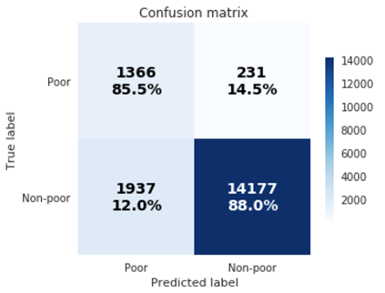
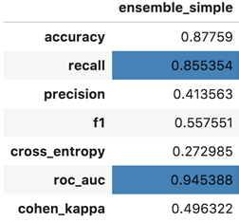
Results: soft voting (top 10 models, IDN)
(Max was 0.6)
Major improvement in recall measure, but low precision
Error on poverty rate : +8.9%
Notes:
We show here the results of “soft voting” (unweighted majority of predictions). The recall measure had a maximum of 0.6 in our set of best models. It now reaches 0.86.

Slide 16
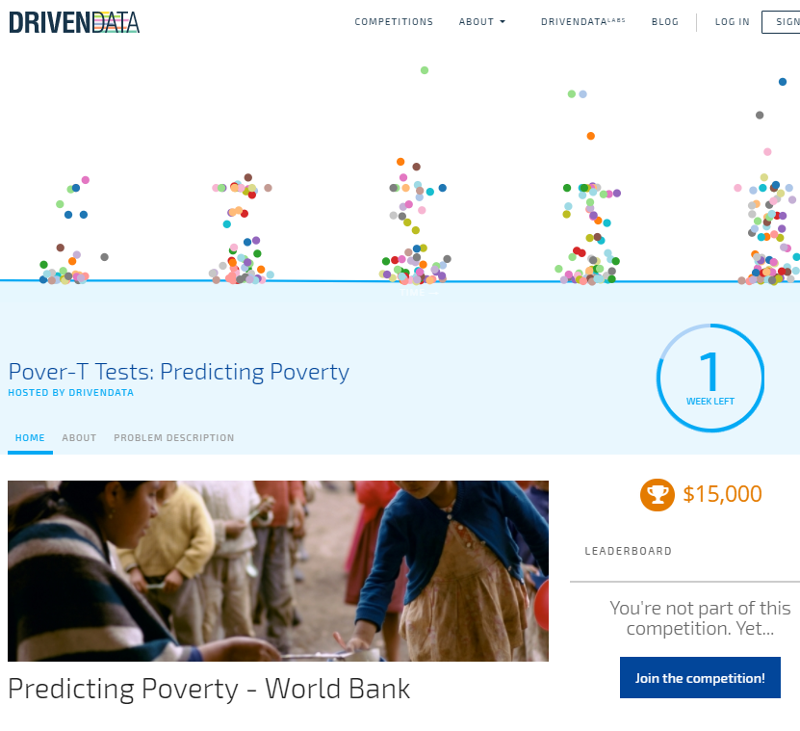
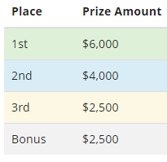
Can the crowd do better?
Data science competition on DrivenData platform
Challenge: predict household poverty status for 3 countries (including MWI)
Notes:
To consider a broader set of possible options, we also organized a data science competition hosted by the DrivenData platform. This challenge enables participants to try out thousands of models using whatever backgrounds, skills, and approaches they see fit. The competition offers the ability to explore new ways to approach modelling problems. The competition is run according to the same best practice used by the Kaggle platform. We provided participants with 3 “masked” datasets (actual data, but participants are not aware of the source of the data).
The total value of prizes is $15,000 divided into 3 (or 4) prizes: the top three participants (individuals or teams) will get prizes of respectively $6K, $4K, and $2.5K. The first participant from a low or lower-middle income country will get a prize (or bonus if s/he is in the top 3) of $2.5K. The models developed by the top 4 (or 3) contestants will be documented and publicly released.

Slide 17
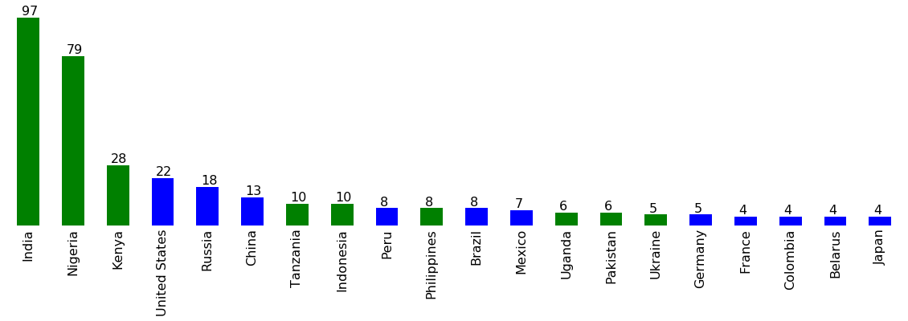
Data science competition - Participation
As of February 22 | Number
Unique submissions | 4,525
Individuals signed-up | 2,081
Individuals submitted | 479
Distribution of registered participants by nationality (for those who provided this information at registration)
Notes:
Participation in the competition exceeded our expectations, with more than 2,000 registered participants and over 4,500 submissions (as of February 22 ; the competition closes on February 28). Participants are asked (not obliged) to indicate their nationality (winners of the prizes will have to give evidence of their origin to qualify for the bonus). India, Nigeria and Kenya are the top 3 countries of origin for participants who reported their nationality.

Slide 18
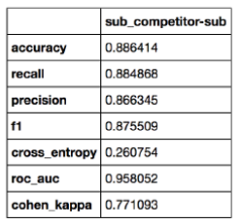
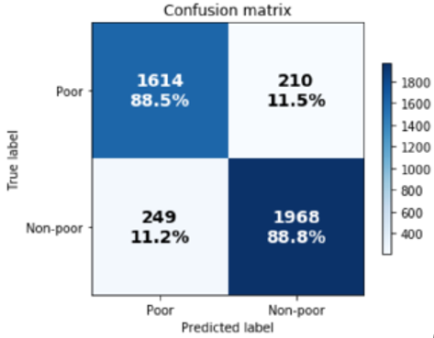
Results (so far) on MWI
Slightly better than the best of 10 algorithms
Good results on all metrics
Score
Notes:
The competition makes use of data from 3 countries, including MWI (same dataset we used for our 10-algorithms assessment). The results (not final) of the competition shows results that are (slightly) better than the outcome of the 10-algorithms exercise. The results are good on all quality metrics. This shows that competitions compare well with a more systematic comprehensive search of the space of possible models.
Note: In the best performing model (so far), the % of false positive and false negative are very close. If we use the model to predict the out-of-sample poverty rate, we obtain an close estimate. This is due to the fact that the two types of errors compensate each other.

Slide 19
Experts – Advanced search for a solution (IDN)
Intuition: a click-through rate (CTR) model developed for Google Play Store’s recommender system could be a good option
High dimensional datasets of primarily binary features; binary label
Combines the strengths of wide and deep neural networks
But requires a priori decision of which interaction terms the model will consider → impractical (too many features to consider interaction between all possible pairs)
Solution: Deep Factorization Machine (DeepFM) by Guo et al. applied to IDN
Notes:
We also contracted highly-qualified experts to build the best possible model for Indonesia. Their intuition was that a model recently developed by researchers at Google to predict the click-through rate (CTR) for the Google Play store, presented close similarities with our challenge. Both are binary classification challenges, with predictors that are mostly binary features.
The Google model however has one major disadvantage: it requires a manual pre-selection of features whose interaction will be exploited by the model. When a dataset has many features – like ours – it is impractical to consider all possible combinations. A solution to this was offered by Guo et al., who developed the “Deep Factorization Machine” (DeepFM). DeepFM was thus applied to the IDN data.

Slide 20
Automated Machine Learning (AutoML)
Goal: let non-experts build prediction models, and make model fitting less tedious
Let the machine build the best possible “pipeline” of pre-processing, feature (=predictor) construction and selection, model selection, and parameter optimization
Using TPOT, an open source python framework
Not brute force: optimization by genetic programming
Starts with 100 randomly generated pipelines; select the top 20; mutate each into 5 offspring (new generation); repeat
Notes:
The last option we are testing to build our predictive model (on IDN) is automated Machine Learning (autoML). There is an increasing demand for tools that can make machine learning accessible to non-experts, and that would help data scientists reduce the time it takes to build models. A lot of research is being undertaken in this area, which is evolving rapidly.
In AutoML, the entire machine learning pipeline–from preliminary processing of the data to model selection and training–may be cast as a minimax optimization problem that seeks to maximize model performance while minimizing the complexity of the pipeline. The idea of automated ML is to let the computer test a large number of options for 3 key steps of model building: feature engineering, model selection, and parameters optimization (the framework builds and tests “pipelines” of feature engineering + model selection + parameters optimization). Cumbersome steps such as feature engineering, which typically require subject matter experts, do not need to be performed manually. This is not just “brute force”; the framework will process by iteration (“generation”), and learn from each iteration to identify the best option for the next one (under constraints of processing time and number of iterations). This approach makes use of genetic programming (new “generations” of pipelines get better than the previous generations).
Open source tools are available. We use TPOT (Tree-Based Pipeline Optimization Tool), an open source framework that makes use of the Python-based scikit-learn library.

Slide 21
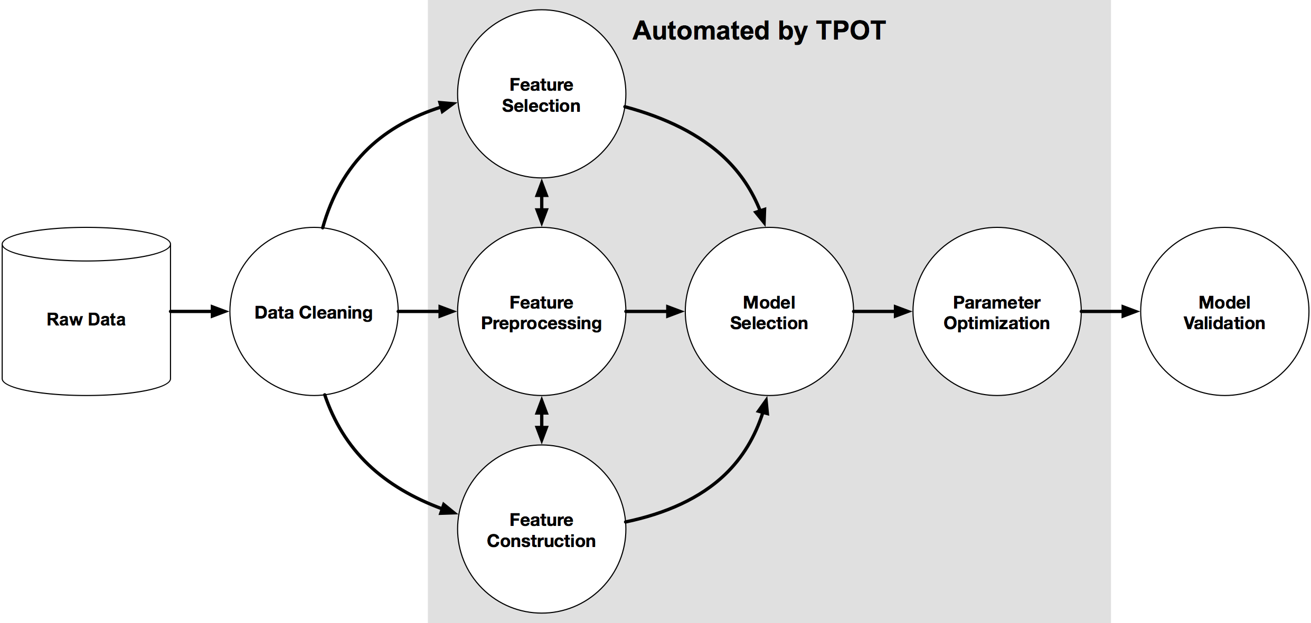
Automated Machine Learning - TPOT
https://github.com/EpistasisLab/tpot
Notes:
TPOT generates pipelines that automate feature selection, preprocessing and construction; model selection ; and parameter optimization.

Slide 22
Automated Machine Learning applied to IDN
A few lines of code, but a computationally intensive process (thousands of models are tested)
~2 days on a 32-processors server (200 generations)
TPOT returns a python script that implements the best pipeline
IDN → 6 pre-processing steps including some non-standard ones (creation of synthetic features), then XGBoost (models assessed on f1 measure)
A counter-intuitive pipeline; it works, but not clear why
Notes:
When using autoML, a time limit or a maximum number of iterations are imposed to the framework. The process is computationally intensive, as each model considered must be implemented. Identifying the “best” model for IDN took around 2 days of processing (20,000 models tested).
TPOT showed “creativity” in the preprocessing stage, generating synthetic features. Then it applied XGBoost to produce the predictions. This shows one weakness of the automated ML approach: it can provide good results, but the reason a specific pipeline is selected are not always clear.

Slide 23
Results: DeepFM, TPOT, and some others (IDN)
Algorithm | Accuracy | Recall | Precision | f1 | Cross entropy | ROC AUC | Cohen Kappa | Mean rank
DeepFM | 0.932 | 0.549 | 0.648 | 0.594 | 0.163 | 0.943 | 0.558 | 3.571
xgb_full_undersample_cv | 0.833 | 0.893 | 0.400 | 0.552 | 0.376 | 0.932 | 0.448 | 4.143
lr_full_oversample_cv | 0.853 | 0.838 | 0.431 | 0.569 | 0.347 | 0.926 | 0.471 | 4.714
nb_full_undersample_cv_isotonic | 0.820 | 0.913 | 0.383 | 0.539 | 0.402 | 0.932 | 0.434 | 5.714
svm_full_undersample_cv | 0.815 | 0.928 | 0.377 | 0.536 | 0.402 | 0.933 | 0.435 | 5.857
mlp_full_undersample_cv | 0.819 | 0.904 | 0.380 | 0.535 | 0.391 | 0.930 | 0.434 | 6.714
rf_full_undersample_cv_ada | 0.823 | 0.907 | 0.386 | 0.542 | 0.530 | 0.931 | 0.429 | 6.857
lr_l1_feats_oversample_cv | 0.831 | 0.843 | 0.393 | 0.536 | 0.383 | 0.915 | 0.408 | 7.286
TPOT | 0.917 | 0.690 | 0.531 | 0.600 | 0.622 | 0.815 | 0.555 | 7.571
lda_full_oversample_cv | 0.814 | 0.887 | 0.372 | 0.524 | 0.425 | 0.922 | 0.408 | 9.286
DeepFM is the best model on many metrics, but with an issue on recall
TPOT is the best performer on f1 and does well on accuracy, but overall it is far from the top performing models
Notes:
We show here the results of DeepFM, TPOT, and other models (from the 10-algorithms test). DeepFM is the best performer on most metrics, and this also on the mean of rank. But it performs poorly on the recall measure. This failure is crucial when the model task is identification of unbalanced classes, and is particularly important in the context of poverty prediction. We will have to investigate (and solve?) this issue. TPOT did very well on accuracy, but poorly on other measures (except f1, which is the measure that it was asked to use to identify the best model). In general, TPOT did not do very well compared to the top performing options.

Slide 24
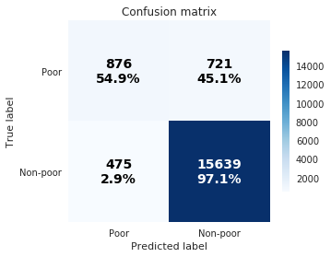
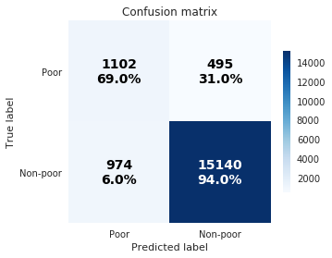
DeepFM and TPOT – Confusion matrices
DeepFM
TPOT
Notes:
The confusion matrices for DeepFM and TPOT show clearly the issue of low recall.
In the remainder of our research, we will further investigate the cause of this poor recall performance in the advanced models (we noticed some overfitting in DeepFM), and either restructure the DeepFM network or explain the failure, as well as further optimize the TPOT pipeline. One avenue of exploration may be training DeepFM with respect to a cost function other than cross-entropy to try and improve recall performance.

Slide 25
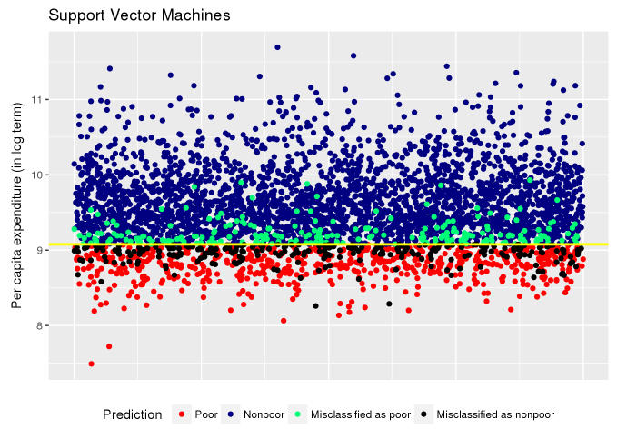
Next steps
Distribution of predictions around the poverty line
Analysis of misclassifications
Test robustness over time
Assess impact of sample size
Expand to regression algorithms
Complement existing and ongoing research
PL
SVM model for Bangladesh 2010
Notes:
We will conduct some analysis of misclassifications (false positive and false negatives). We are interested to find out if misclassified households are close or far from the poverty line. If they are concentrated around the PL, the errors are less preoccupying (the sample surveys themselves have errors). The misclassified observations that are far from the poverty line will be investigated (we cannot assume that the survey data are always “true”; they might contain outliers in the reported or calculated consumption variables).
We will also apply the best performing models to other, comparable datasets from MWI and IDN (data collected 2 years before, and 2 years after the survey used to train the model).
All output (Jupyter notebooks) will be published in GitHub, and a working paper will be produced.
Ideally, we would like to extend this work to regression algorithms (to complement existing and ongoing research work by other researchers within and outside the Bank).

Slide 26
Some takeaways
ML provides a powerful set of tools for classification/prediction
Predicting poverty rates is challenging (we need better predictors more than we need better tools)
Results should always be reported using multiple quality metrics
Different performance metrics are appropriate for different purposes
Good model = model “fit for purpose”
Quality has multiple dimensions (predictive performance, computational constraints, interpretability, and ease of deployment/maintenance/updating)
Openness and full reproducibility must be the rule
Open data when we can ; open source software preferably ; open scripts always
Documented scripts published in GitHub (Jupyter Notebooks, R Markdown)
Need a metadata standard for cataloguing, and to foster meta-learning
Notes:
A working conclusion appears to be that while many of the models perform well, none particularly stand out as the best. Considering computational efficiency and interpretability, it appears that simpler approaches such as over-sampled logistic regression may offer a good trade off between practicality and effectiveness.
Any model produced for operational work should provide information on choice of quality metrics, and report on multiple metrics.
The Bank should have protocols and best practice for model building, documentation, and dissemination. Publishing open and well documented scripts should be the rule. Jupyter Notebooks, R Markdown, and GitHub provide us with powerful solutions to guarantee reproducibility, transparency, and adaptability.
We should also develop a “metadata standard” for cataloguing models (started at DECDG). This will help making the models discoverable, and could foster “meta learning”.

Slide 27
Topic Modeling A quick look at 145,000 World Bank documents

Slide 28
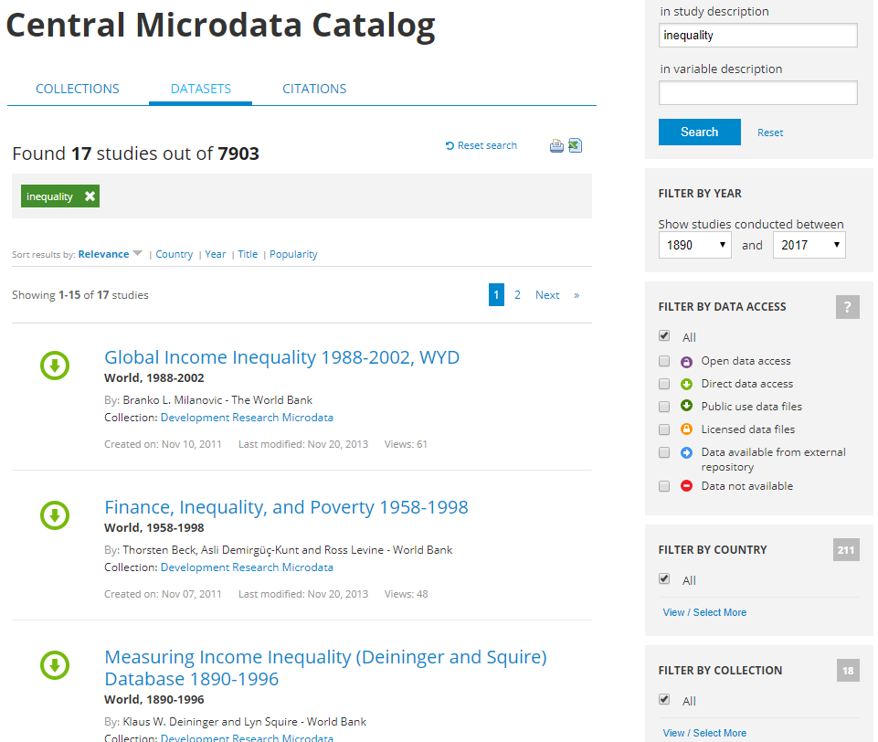
Improving data (and document) discoverability
Our data discovery solutions are not optimal
E.g., searching “inequality” in the WB Microdata Library only returns 17 surveys
Reason: relies on full-text search on survey metadata
“Inequality” not in survey metadata
One solution: mine the analytical output of surveys (70,000+ citations)
Notes:
The WB maintains rich and popular data catalogs. But data discoverability is not fully satisfactory. Discovery tools still rely on pre-defined filters, and full-text search in the (limited) metadata available for each dataset. We could improve data discoverability by mining information from documents citing the datasets we publish. The Microdata Library has a catalog of 70,000+ documents (working papers, journal articles, etc.) linked to the surveys listed in the Survey Catalog.

Slide 29
Improving data (and document) discoverability
What we want:
Fully automatic extraction of topics covered in these documents
An open source solution which does not require a pre-defined taxonomy (not a topic tagging system)
One solution: Latent Dirichlet Allocation (LDA) algorithm
LDA topics are lists of keywords likely to co-occur
User-defined parameter for the model: number of topics
Before applying it to survey citations, we tested it on the WB Documents and Reports - a well curated collection of > 200,000 documents openly accessible through an API
Notes:
If we could automatically extract topics covered in each one of these documents, we could enrich the survey metadata and improve data discoverability. This topic extraction must be implemented in an “unsupervised” manner, i.e. not require any pre-determined list of topics.
We also want an open source solution, as we publish the Microdata Library software as open source software.
The Latent Dirichlet Allocation topic modeling algorithm (Blei and Ng), and its implementation in Java (Mallet) or Python (scikit-learn) meet our criteria. We tested them on a well-curated, large collection of publicly accessible documents: the WB Documents and Reports.

Slide 30
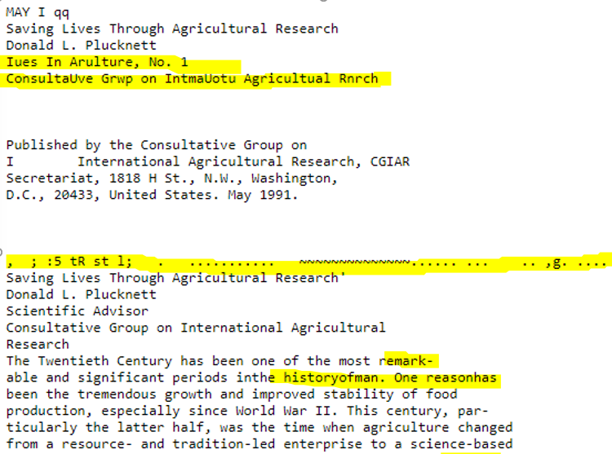
Preparing data
Text is unstructured, sometimes messy data
A “cleaning” process is required
Notes:
Many documents in Documents and Reports have been scanned and OCR’d. The Optical Character Recognition is not always fully accurate, and generates many errors (millions of words not in English dictionary). A cleaning procedure was thus required prior to the topic modeling.

Slide 31
Preparing data - Procedures
We clean the text files (Python, NLTK library)
Detect language; keep document if > 98% in English
Lemmatization (convert words to their dictionary form)
Remove numbers, special characters, and punctuation
Remove words that are not in the English Dictionary
Remove stop-words (“and”, “or”, “the”, “if”, etc.)
We obtain a clean corpus (145,000 docs ; ~ 800 million words)
Generate a “bag of words” (documents/terms matrix)
We run the LDA model (Mallet package)
Output published in a topic browser (adapted from dfr-browser)
Notes:
The NLTK library (Python) was used to clean 197,000 documents. Some documents, containing too few words, not fully in English, or not readable) had to be excluded. We kept ~145,000 documents for analysis.
We used the Mallet implementation of the LDA algorithm, and also exploited an R package to generate output in a format compatible with an open source topic browser (dfr browser, by A. Goldstone). The output of the models is automatically published in this browser.

Slide 32
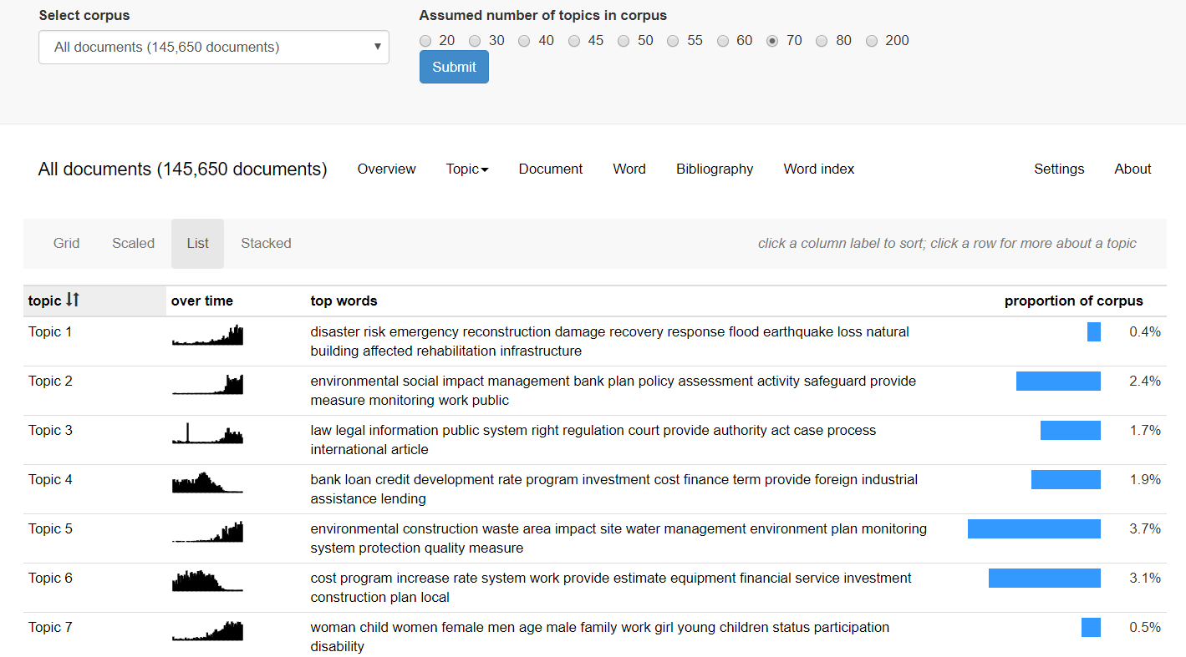
Notes:
Our topic browser (an adapted version of dfr browser by Andrew Goldstone) displays the list of topics identified in a selected corpus.

Slide 33
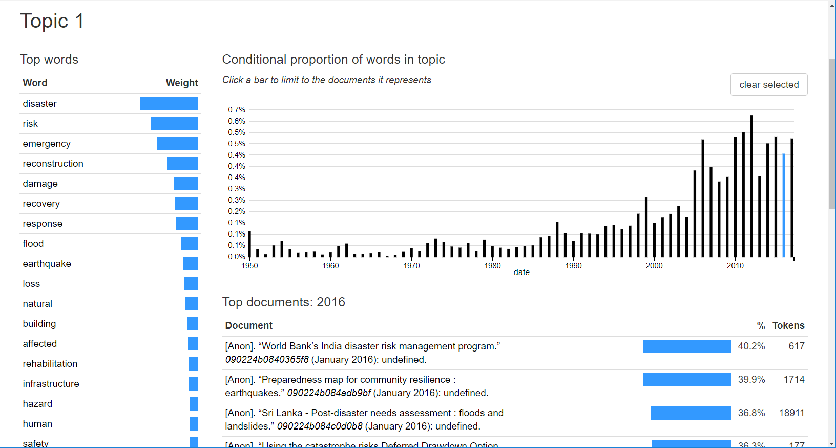
Notes:
The browser allows users to select a topic, and a year. The browser will display the list of “top documents” (the documents in which the share of the topic is the highest).

Slide 34
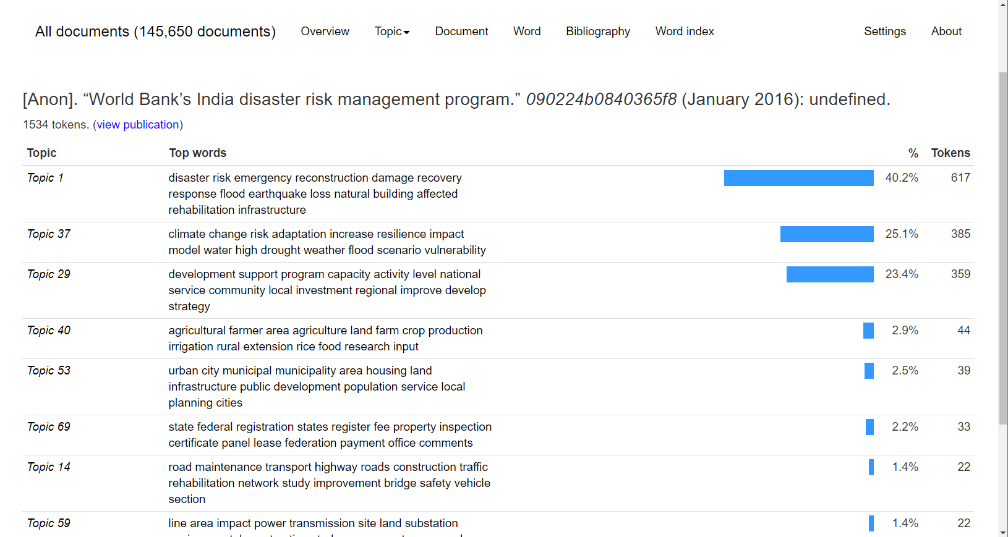
Notes:
When selecting (viewing) a specific document, the browser displays the topic composition of the document (and provides a link to the Document and Reports where the document can be found)

Slide 35
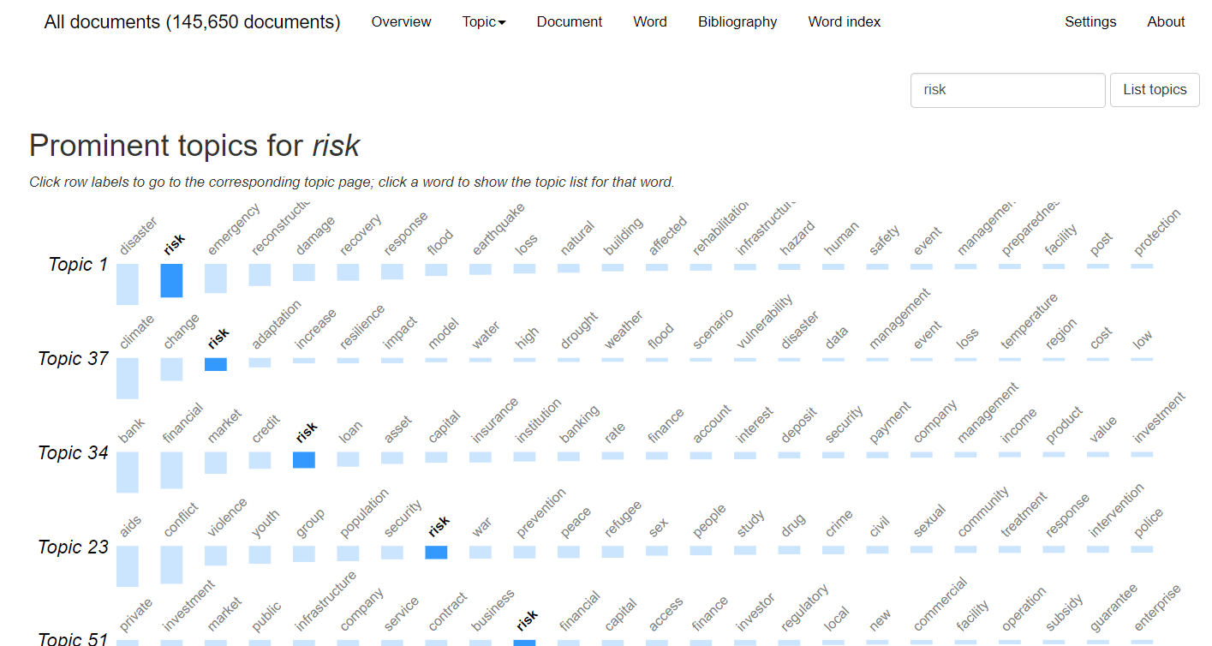
Notes:
The browser also allows users to enter a keyword, and find out how prominent the word is in the identified topics. In the “70 topics model”, “risk” is found in multiple topics.

Slide 36
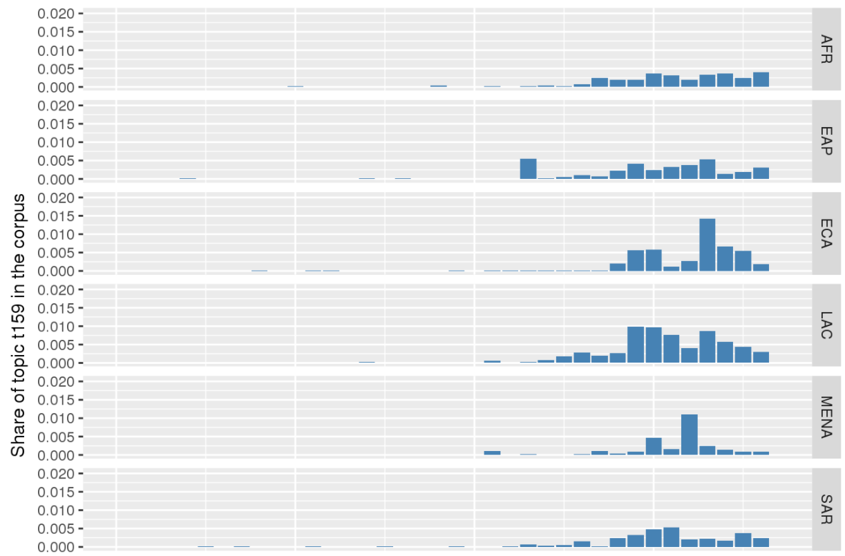
Analysis: differences across regions
1980 – 2017
climate, change, adaptation, increase, impact, resilience,
risk,
water, vulnerability
AFR
EAP
ECA
LAC
MENA
SAR
Notes:
We can also analyze differences across regions (the slide shows that the “climate change” topic is covered in AFR less than in other regions (note: non-region-specific documents are not include the in the chart; many WB documents on climate change are “global” and not region-specific.)

Slide 37
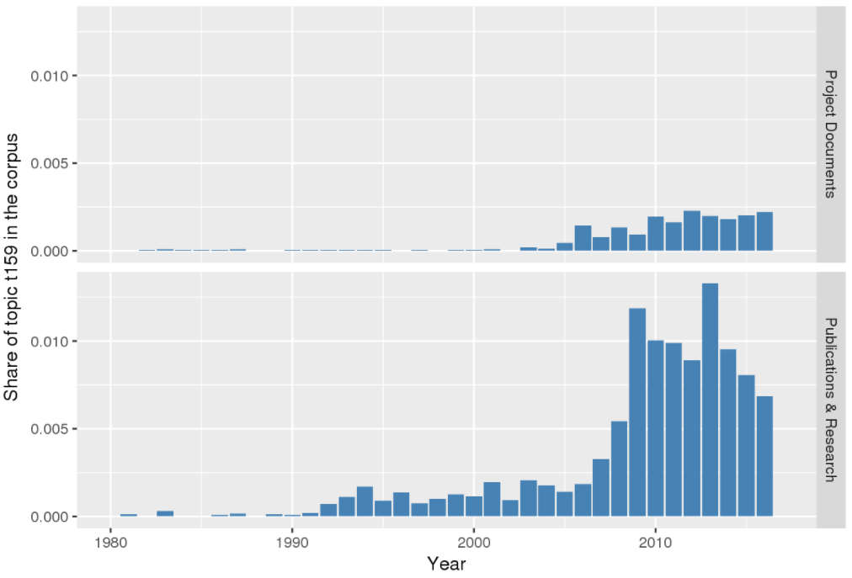
Analysis: differences across document types
Project documents
climate, change, adaptation, increase, impact, resilience, risk,
water, vulnerability
Publications & Research

Slide 38
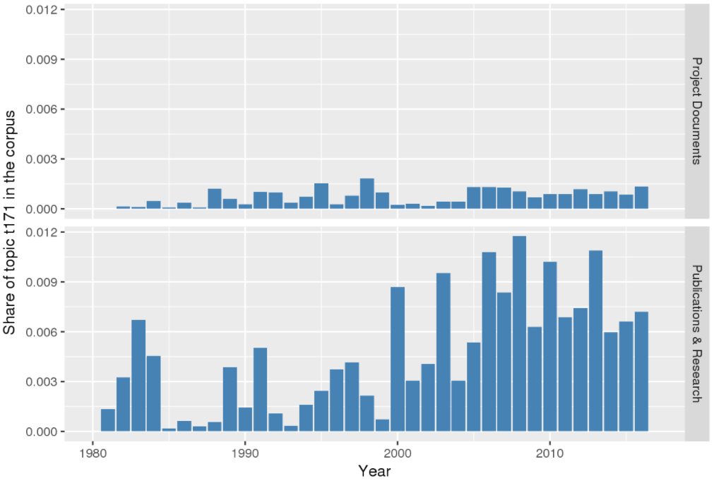
Analysis: differences across document types
Project documents
technology, innovation,
new, development, knowledge, market, economy, competitiveness
Publications & Research

Slide 39
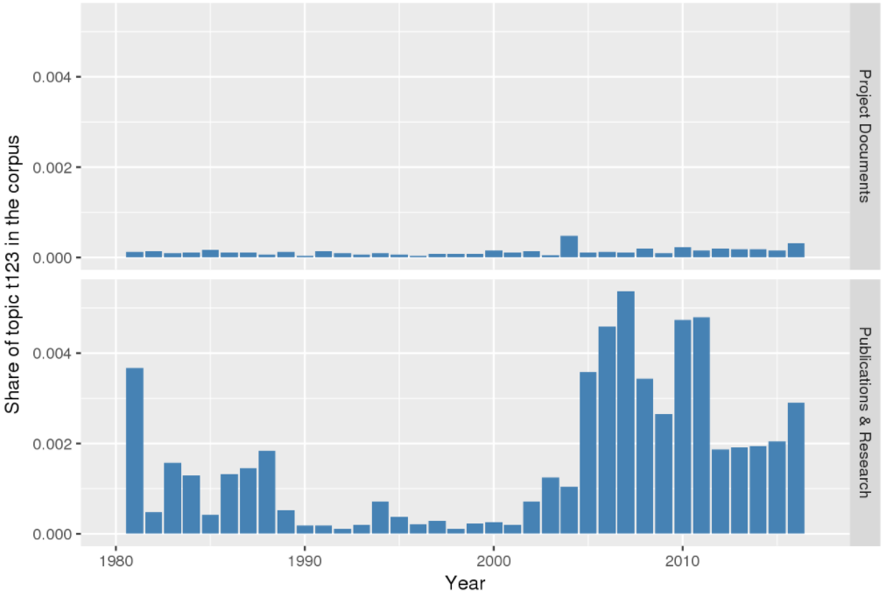
Analysis: differences across document types
Project documents
migration, migrant, remittance, international, home,
return, diaspora
Publications & Research

Slide 40
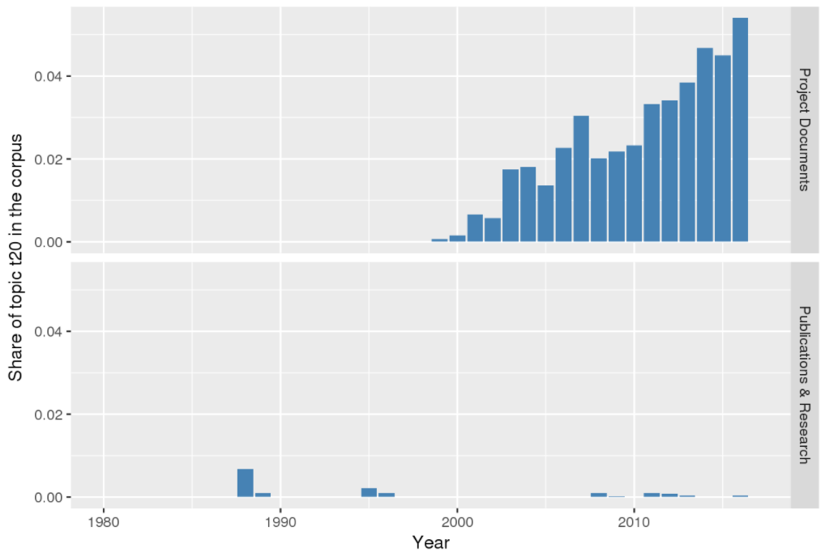
Analysis: differences across document types
Project documents
land, resettlement, compensation, affected,
policy,
area, community
Publications & Research

Slide 41
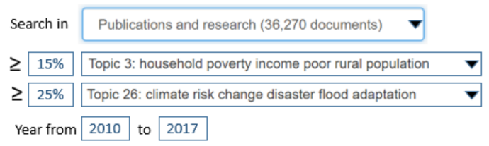
Finding documents based on topic composition
1 | Model and methods for estimating the number of people living in extreme poverty because of the direct impacts of natural disasters
2 | The Varying Income Effects of Weather Variation - Initial Insights from Rural Vietnam
3 | Weathering storms : understanding the impact of natural disasters on the poor in Central America
4 | The exposure, vulnerability, and ability to respond of poor households to recurrent floods in Mumbai
5 | Climate and disaster resilience of greater Dhaka area : a micro level analysis
6 | Why resilience matters - the poverty impacts of disasters
7 | The poverty impact of climate change in Mexico
Notes:
The information on each topic’s “weight” in each document, and the metadata associated with each document (document type, year, region, etc.) can be used to find documents. We did not develop a User Interface for this yet (easy to implement) – we do the search in R. This is a powerful tool to identify documents of interest. It complements nicely the filter options provided by the WB Documents and Reports system.

Slide 42
Finding closest neighbors
Upload or select a document, and find the N closest neighbors, e.g.:
Monga, C. 2009. Uncivil societies - a theory of sociopolitical change
Top 10
Inclusion matters : the foundation for shared prosperity
Representational models and democratic transitions in fragile and post-conflict states
How and why does history matter for development policy ?
Somalia and the horn of Africa
Limited access orders in the developing world :a new approach to the problems of development
Intersubjective meaning and collective action in 'fragile' societies : theory, evidence and policy implications
Equilibrium fictions : a cognitive approach to societal rigidity
The new political economy : positive economics and negative politics
The politics of the South : part of the Sri Lanka strategic conflict assessment 2005 (2000-2005)
Civil society, civic engagement, and peacebuilding
Notes:
Another possible use of the system is to find “closest neighbors” (based on a criteria of topic coverage). We could easily develop an on-line system that would allow users to upload a document (or select one in a catalog), and find the N documents that are the closest match in terms of topic composition. For example, a researcher could upload a description of a research project, which would be “cleaned” (apply the same cleaning process that we applied to the corpus), topics would be inferred, and N closest neighbors will be identified (using Euclidian distance or other) and returned (with link to the documents and option to download them. In the slide, we show the list of 10 closest neighbors identified in the corpus of 150,000 WB documents for a Policy research Working paper by Celestin Monga.

Slide 43
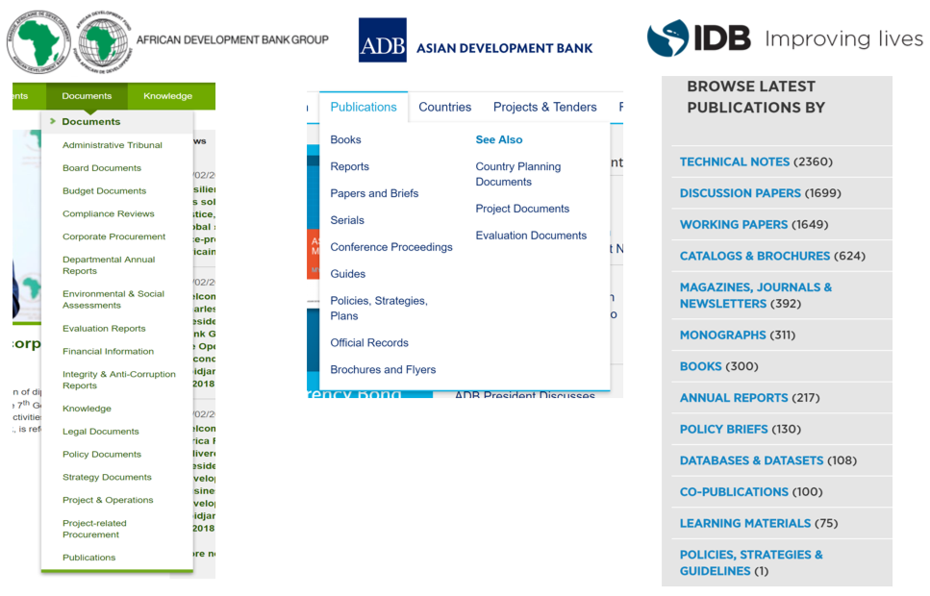
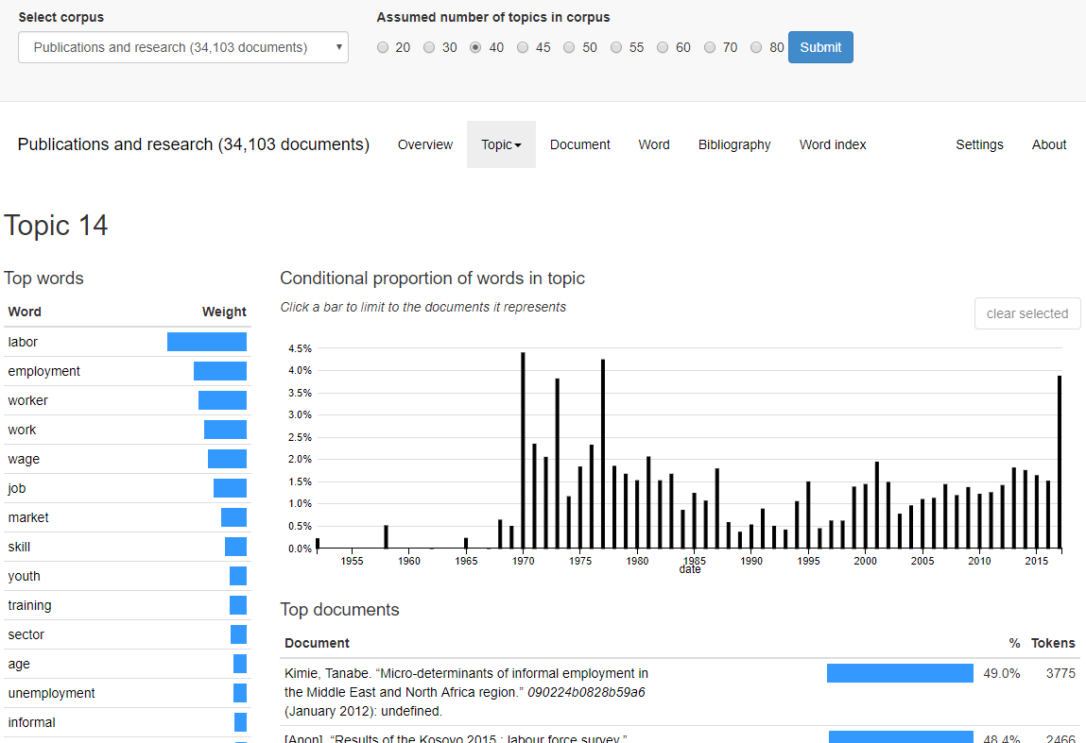
Expanding the corpus (not yet implemented)
A fully automated system collects documents from WB and other organizations, “cleans” them, extract topics, and update the browser and search UI
Web scraping (cron job; e.g. weekly run)
Process documents and infer topics
Publish in browser / search interface
Notes:
The system can be fully automated (with cron jobs that would run for example once a week to update the topics/document database).
We could also extend the scope and coverage of the system, by exploiting web scraping technology. Documents from other organizations (e.g., research and project documents from ADB, AfDB, and IDB) could be included through a fully-automated process.
This system could complement the tools provided by Documents and Reports to facilitate knowledge discovery.

